Slide 1

HR Employee Attrition
By :
Syed Ameen

Slide 2
Objective:
HR Employee Attrition is the process of employees leaving an organization voluntarily or involuntarily. It is a major concern for HR professionals as it affects the organization’s ability to retain talent and maintain productivity. Employee attrition can be caused by a variety of factors, such as lack of job satisfaction, inadequate salary and benefits, poor working conditions, and lack of career advancement opportunities.

Slide 3

About Dataset
The key to success in any organization is attracting and retaining top talent. As an HR analyst one of the key task is to determine which factors keep employees at the company and which prompt others to leave. Given in the data is a set of data points on the employees who are either currently working within the company or have resigned. The objective is to identify and improve these factors to prevent loss of good people.
There are 1470 rows & 35 columns in this dataset

Slide 4

Feature description:
AGE Numerical Value
ATTRITION Employee leaving the company (0=no, 1=yes)
BUSINESS TRAVEL (1=No Travel, 2=Travel Frequently, 3=Travel Rarely)
DAILY RATE Numerical Value - Salary Level
DEPARTMENT (1=HR, 2=R&D, 3=Sales)
DISTANCE FROM HOME Numerical Value - THE DISTANCE FROM WORK TO HOME
EDUCATION Numerical Value. (1 'Below College' 2 'College' 3 'Bachelor' 4 'Master' 5 'Doctor’)
EDUCATION FIELD (1=HR, 2=LIFE SCIENCES, 3=MARKETING, 4=MEDICAL SCIENCES, 5=OTHERS, 6= TECHNICAL)
EMPLOYEE COUNT Numerical Value

Slide 5
ENVIRONMENT SATISFACTION Numerical Value - SATISFACTION WITH THE ENVIRONMENT (1 'Low' 2 'Medium' 3 'High' 4 'Very High’)
GENDER (1=FEMALE, 2=MALE)
HOURLY RATE Numerical Value - HOURLY SALARY
JOB INVOLVEMENT Numerical Value - JOB INVOLVEMENT (1 'Low' 2 'Medium' 3 'High' 4 'Very High’)
JOB LEVEL Numerical Value - LEVEL OF JOB
JOB ROLE (1=HR REP, 2=HR, 3=LAB TECHNICIAN, 4=MANAGER, 5= MANAGING DIRECTOR, 6= RESEARCH
JOB SATISFACTION Numerical Value - SATISFACTION WITH THE JOB (1 'Low' 2 'Medium' 3 'High' 4 'Very High’)
MARITAL STATUS (1=DIVORCED, 2=MARRIED, 3=SINGLE)
MONTHLY INCOME Numerical Value - MONTHLY SALARY

Slide 6
NUMCOMPANIES WORKED Numerical Value - NO. OF COMPANIES WORKED AT
OVER 18 (1=YES, 2=NO)
OVERTIME (1=NO, 2=YES)
PERCENT SALARY HIKE Numerical Value - PERCENTAGE INCREASE IN SALARY
PERFORMANCE RATING Numerical Value - PERFORMANCE RATING
RELATIONS SATISFACTION Numerical Value - RELATIONS SATISFACTION
STANDARD HOURS Numerical Value - STANDARD HOURS
STOCK OPTIONS LEVEL Numerical Value - STOCK OPTIONS (Higher the number, the more stock option an employee has)
TOTAL WORKING YEARS Numerical Value - TOTAL YEARS WORKED

Slide 7
EMPLOYEE NUMBER Numerical Value - EMPLOYEE ID
TRAINING TIMES LAST YEAR Numerical Value - HOURS SPENT TRAINING
MONTHLY RATE Numerical Value - MONTHLY RATE
WORK LIFE BALANCE Numerical Value - TIME SPENT BETWEEN WORK AND OUTSIDE
YEARS AT COMPANY Numerical Value - TOTAL NUMBER OF YEARS AT THE COMPANY
YEARS IN CURRENT ROLE Numerical Value -YEARS IN CURRENT ROLE
YEARS SINCE LAST PROMOTION Numerical Value - LAST PROMOTION
YEARS WITH CURRENT MANAGER Numerical Value - YEARS SPENT WITH CURRENT MANAGER

Slide 8
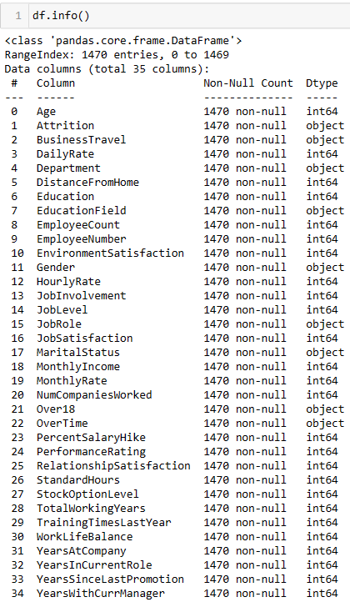
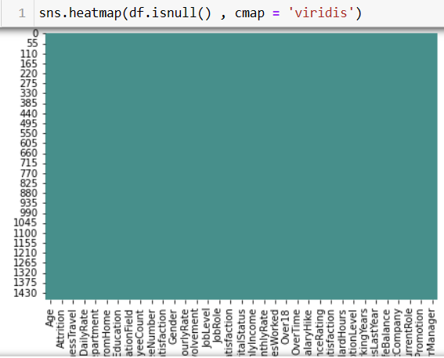
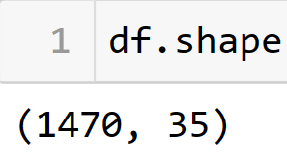
Data preparation
35 Columns and there Dtype
From above graph, we can see that there are no missing values in our dataset.

Slide 9

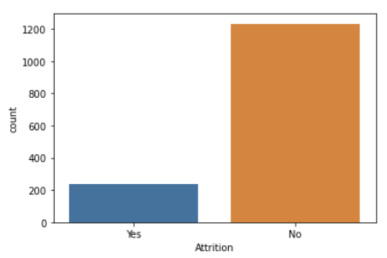
EDA
Data of Attrition says that it has more number of "No" values and less number of "Yes".
It can be seen that there is big difference in counts of values so we can say that it is Imbalanced Data
Distribution of target/dependent variable, Attrition

Slide 10
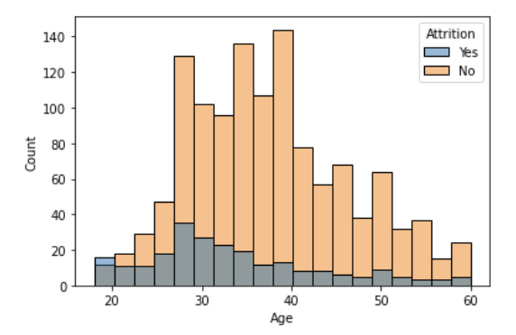
Relationships of target variable with other variables
Employees in age of 25 to 35 are more likely to leave the job
After 48 age, the distribution tells us that “Higher the age Lesser will be attrition”
Attrition VS Age

Slide 11
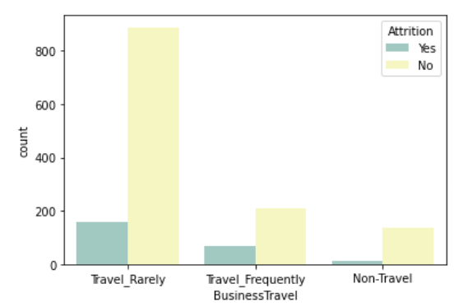
Graph tells us that company has more count or more number of employees who travels rarely. It means travel rate of company is less
There are more employees who travels rarely and they are not satisfied with their job
Non-Traveller have least count as well as least attrition
Attrition VS Business Travel

Slide 12
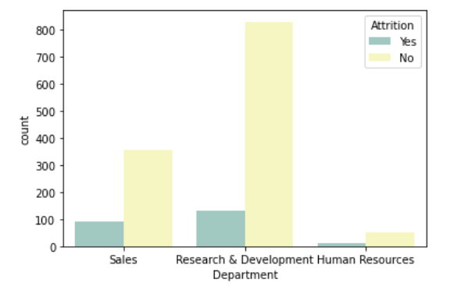
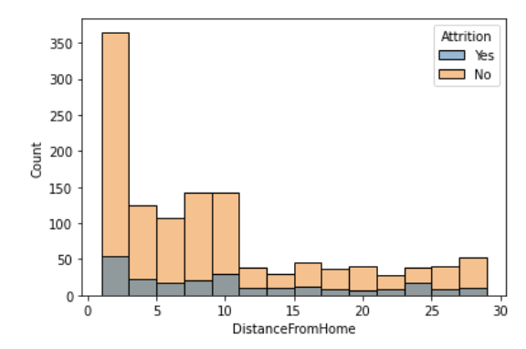
The Research and Development department have more number of Attrition (150 employees) as compared to other two department
‘HR Department’ have least Attrition with just 5 to 10 employees
Attrition VS Department
Employee who has distance range of 0-10 km are more likely to leave the job
We can also conclude that lesser the distance more number of employees are working
Attrition VS Distance from Home

Slide 13
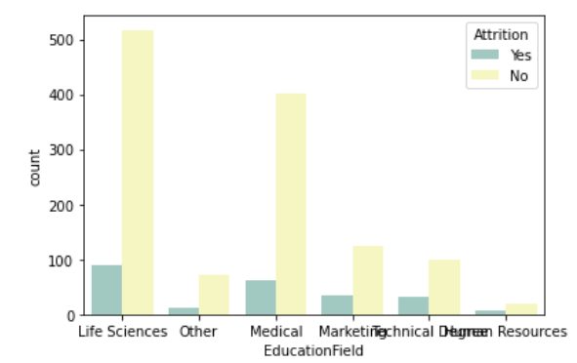
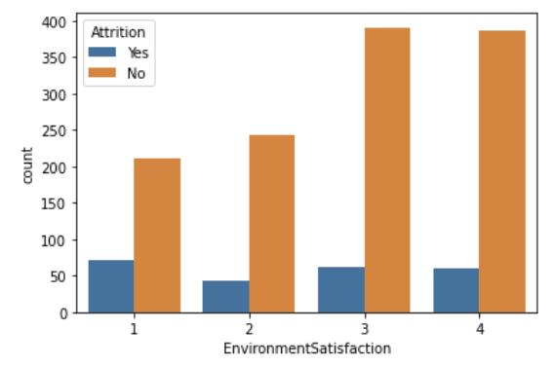
First and foremost thing is that Employees who are from ‘Life science’ and ‘Medical’ background are more as compared to other education fields
As we conclude from analysis of Department and Attrition, here also HR educational background employees have least attention
Attrition VS Education field
Attrition VS Environment satisfaction
Increase in rate of Environment satisfaction gives rise to increase in Attrition “No”

Slide 14
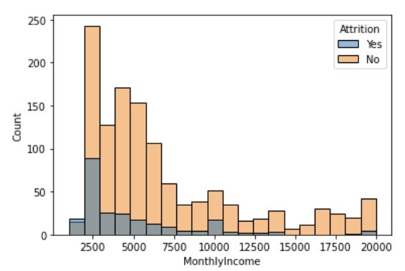
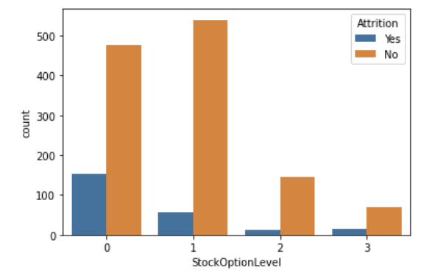
Higher the monthly income give rise to less Attrition
Employees who have their income aprox 2.5 K are more likely to quit their job because 2.5k is least range of income
Attrition VS monthly income
For the employees who were not having stocks option are likely to quit their job
Attrition VS Stock option level

Slide 15
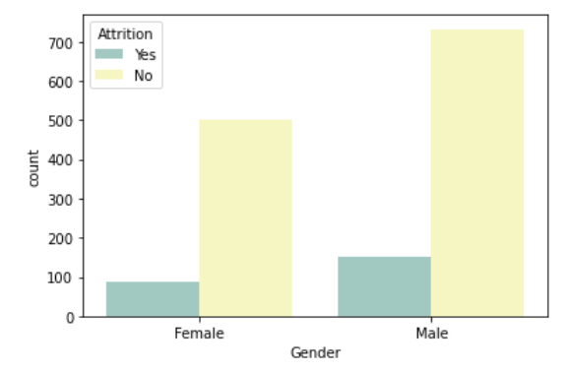
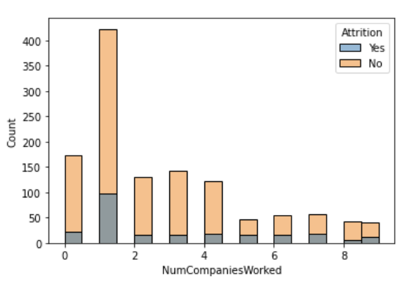
Male employees are more as compared to Female’s
Male are more likely to quit their job rather than Females
Attrition VS Gender
Attrition VS No. of companies worked
Only that employee (no. of employee =100) who worked with 1 company before have most Attrition, rest have similar data

Slide 16
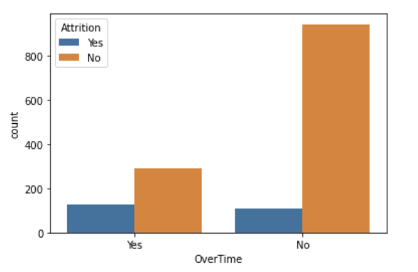
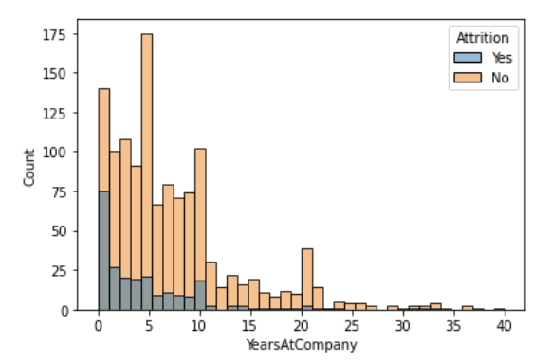
As for ‘Attrition Yes’ there is minor difference between the Employees who are doing overtime and who are not doing overtime
But we can conclude the most of employees are not doing overtime
Attrition VS Over Time
Freshers have higher data of ‘Attrition Yes’ that is of 75 no. of workers or more than half of freshers
Apart from this Employees who range from 1 to 10 year working on this company also likely to quit their job
Attrition VS Year at Company

Slide 17
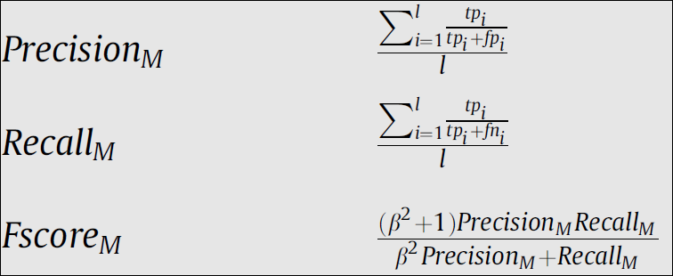
Data Modeling
This stage involves training a machine learning model with all the given features to make prediction for the target variable Attrition
To measure the performance of our algorithms, We will use the F1 score which balance the precision and recall of a classifier. The F1 score is used to evaluate performance on a binary classifier

Slide 18

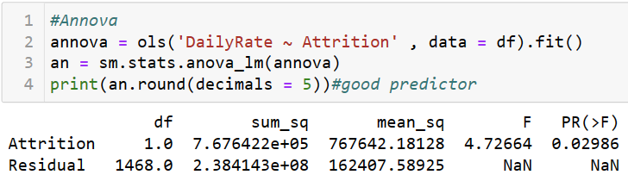

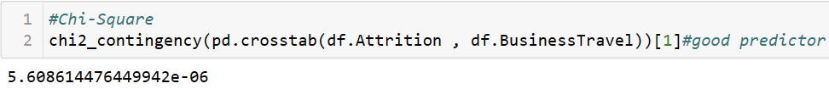
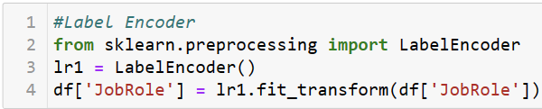
Before the model is fitted on the data necessary feature transformation was performed on the data which include the following;
Feature scaling
Converting categorical columns into numerical using label encoding mapping
Dropping features based on statistical tests like ANNOVA and CHI-SQUARE tests
SMOTE to balance the imbalanced target variable
1.
3.
2.

Slide 19
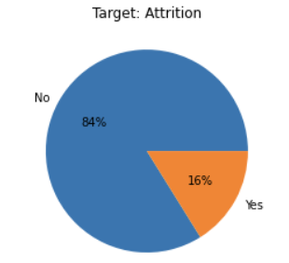

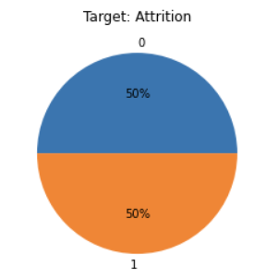

4.
Our target variable class is imbalanced, so we will use SMOTE to over sample the minority class for balancing

Slide 20
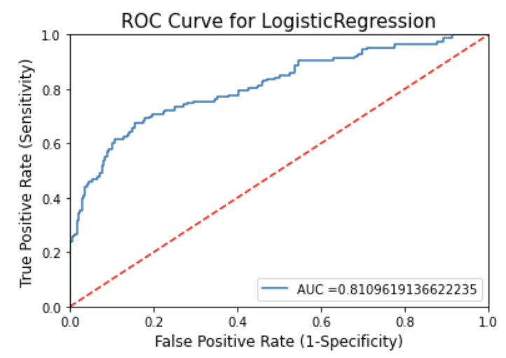

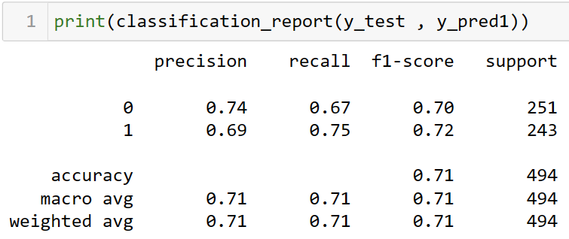
Building Multiple models to find best Accuracy
Logistic Regression

Slide 21


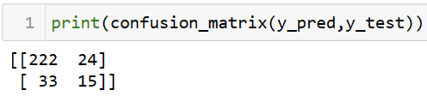
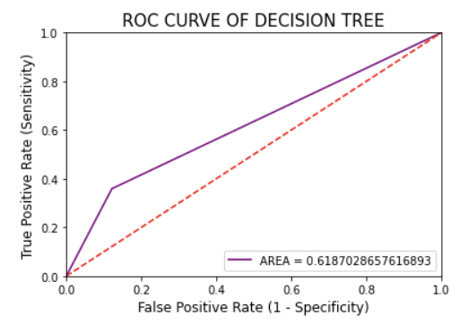
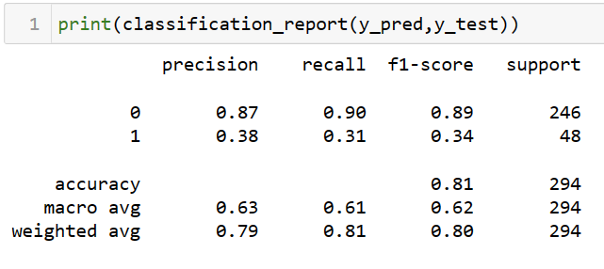
Decision Tree Classifier

Slide 22


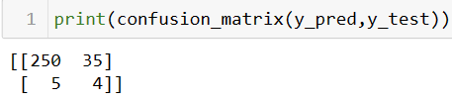
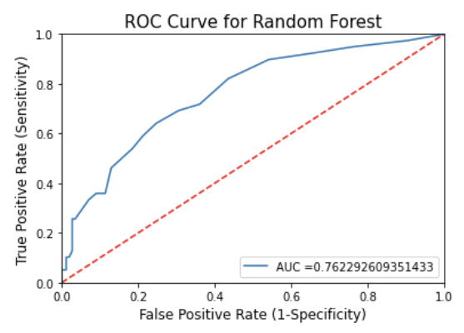
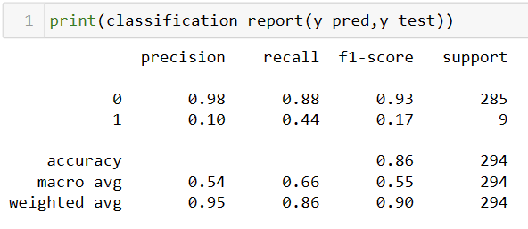
Random Forest

Slide 23

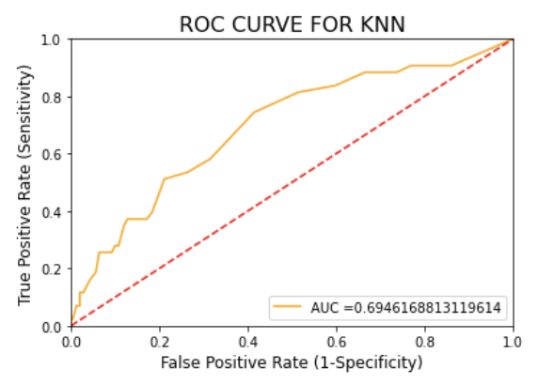

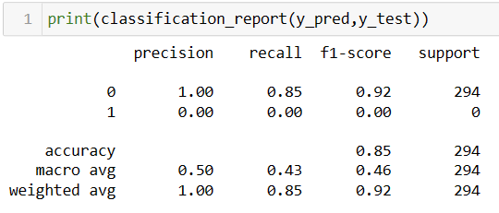
KNN

Slide 24
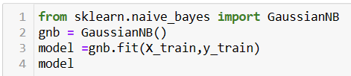
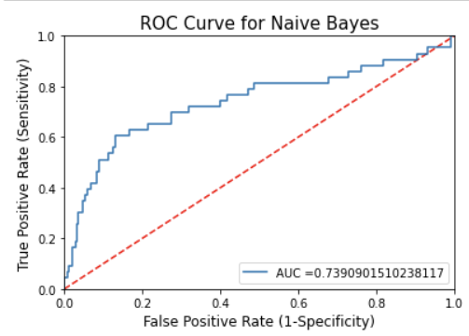
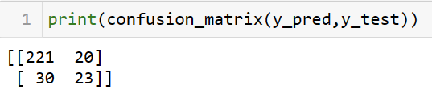
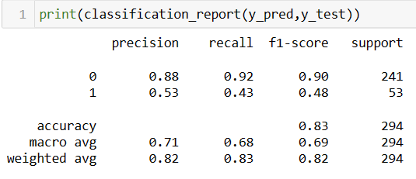
Naive Bayes

Slide 25
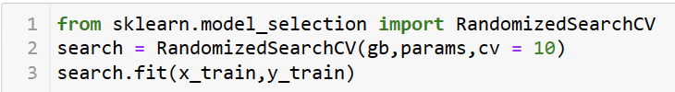
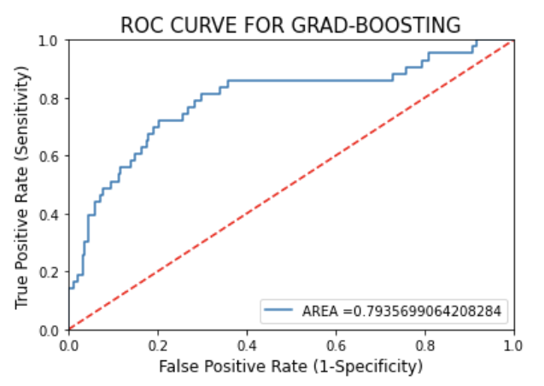
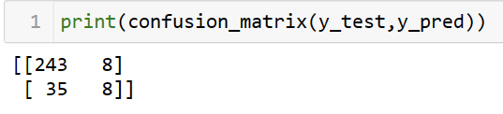
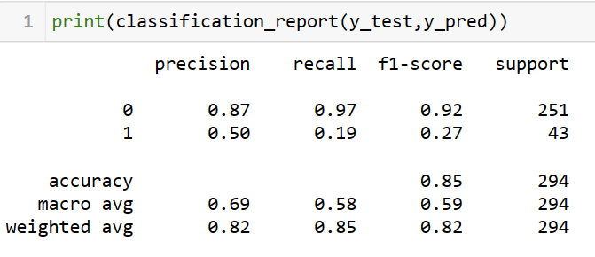
GRADIENT BOOSTING

Slide 26
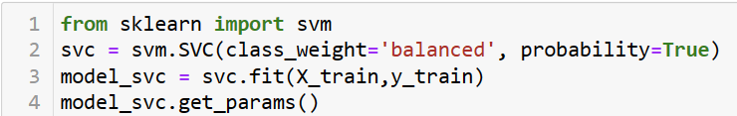
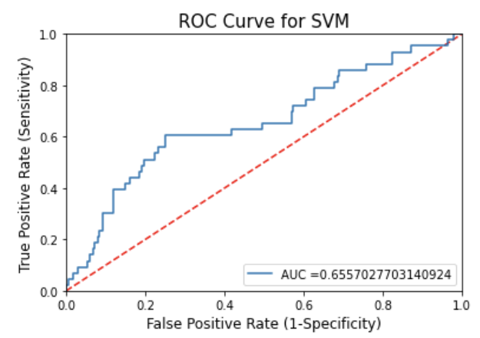
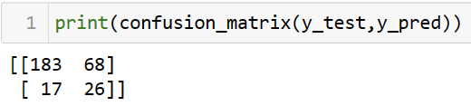
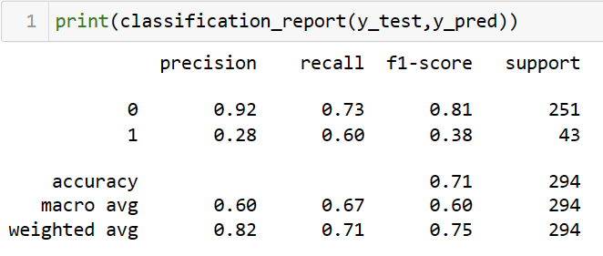
SVM

Slide 27
Conclusion:
We tried to build a prediction model for the HR Attrition in which we need to predict that the Employee would be stay(Yes) or leave (No) the company .
For that first we needed to understand the data.
Then visualise it and handle the data appropriately.
And balance the unbalanced data.
Finally build multiple model to evaluate and to find the best suited model to get good accuracy score and predict the target.
In that, Random Forest model showed the highest accuracy .so, we used it to predict the data.

Slide 28



